Slide 1

Flight Delay Prediction Using PySpark
Team - DYNAMIC DUDES
Team - DYNAMIC DUDES
AIE19013
AIE19014
AIE19062
Charan Tej. K
Ch. Surya Teja
Sugash T.M

Slide 2







STEP 02
STEP 04
STEP 06
Spark
Machine learning algorithm
Sample Output
STEP 01
STEP 03
STEP 05
STEP 07
Introduction
Dataset
Implementation
Conclusion

Slide 3


Introduction

Slide 4


Introduction
In our project we are going to predict the delay in arrival of several flights across all airports
In this project for data preprocessing we are using PySpark module so that we can handle the heavy data
We'll train a Logistic Regression model with a Pipeline preparing the data and predicting the required feature

Slide 5

Spark

Slide 6

Spark
Apache Spark is an open-source unified analytics engine for large-scale data processing.
Spark provides an interface for programming entire clusters with implicit data parallelism and fault tolerance.
PySpark is an interface for Apache Spark in Python. It not only allows you to write Spark applications using Python APIs, but also provides the PySpark shell for interactively analyzing your data in a distributed environment.

Slide 7
Dataset

Slide 8

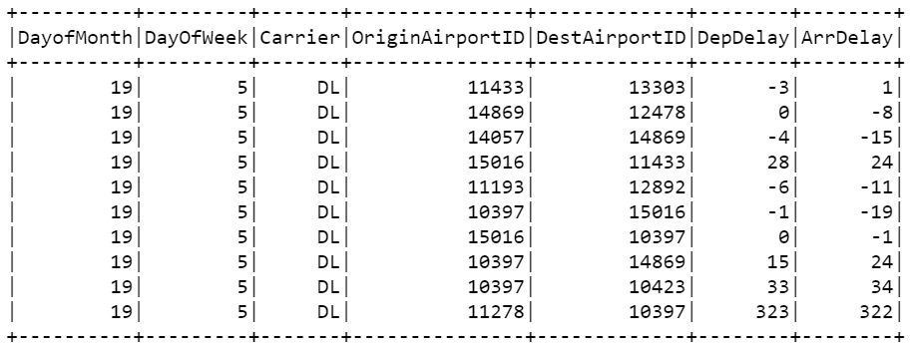
Dataset
The data from the flight.csv file data includes specific characteristics (or features) for each flight, as well as a column indicating how many minutes late or early the flight arrive

Slide 9

Machine Learning

Slide 10

Machine Learning
We are using Logistic Regression classifier to train our data and predict the required output.
Logistic regression models are models that have a certain fixed number of parameters that depend on the number of input features, and they output categorical prediction, like for example if the flight is delayed or not.
Pipeline consists of a series of transformer and estimator stages that typically prepare a DataFrame for modeling and then train a predictive model. In this case, we will create a pipeline with six stages.

Slide 11
Machine Learning
A StringIndexer estimator that converts string values to indexes for categorical features
A VectorAssembler that combines categorical features into a single vector
A VectorIndexer that creates indexes for a vector of categorical features
A VectorAssembler that creates a vector of continuous numeric features
A MinMaxScaler that normalizes continuous numeric features
A VectorAssembler that creates a vector of categorical and continuous features

Slide 12
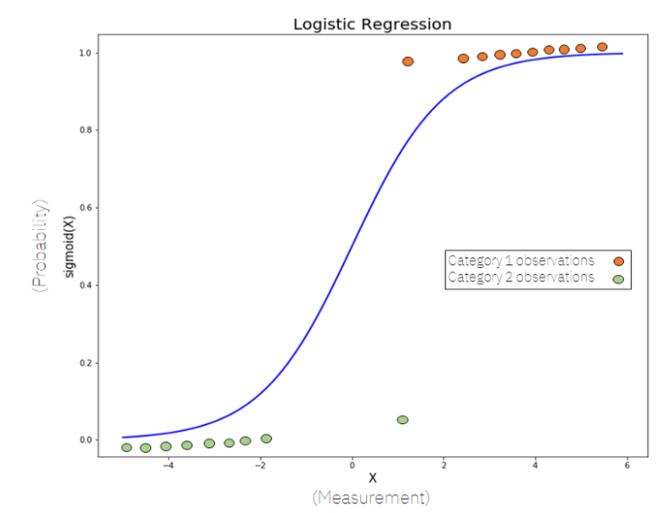
Machine Learning

Slide 13

Implementation

Slide 14

Implementation
Importing Dependencies
Encoding and Processing
Evaluation of the model
$$1^{st}$$
$$2^{nd}$$
$$3^{rd}$$
$$4^{th}$$
$$5^{th}$$
Data Visualization
Training and Testing the data using Logistic Regression
14

Slide 15

Output

Slide 16

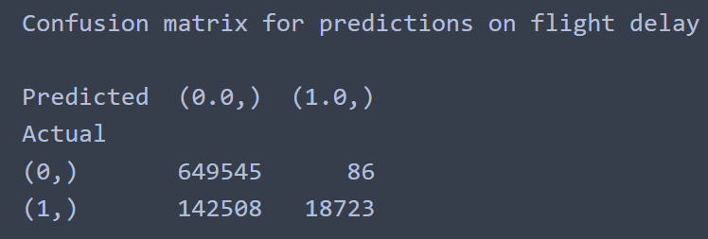
Output

Slide 17
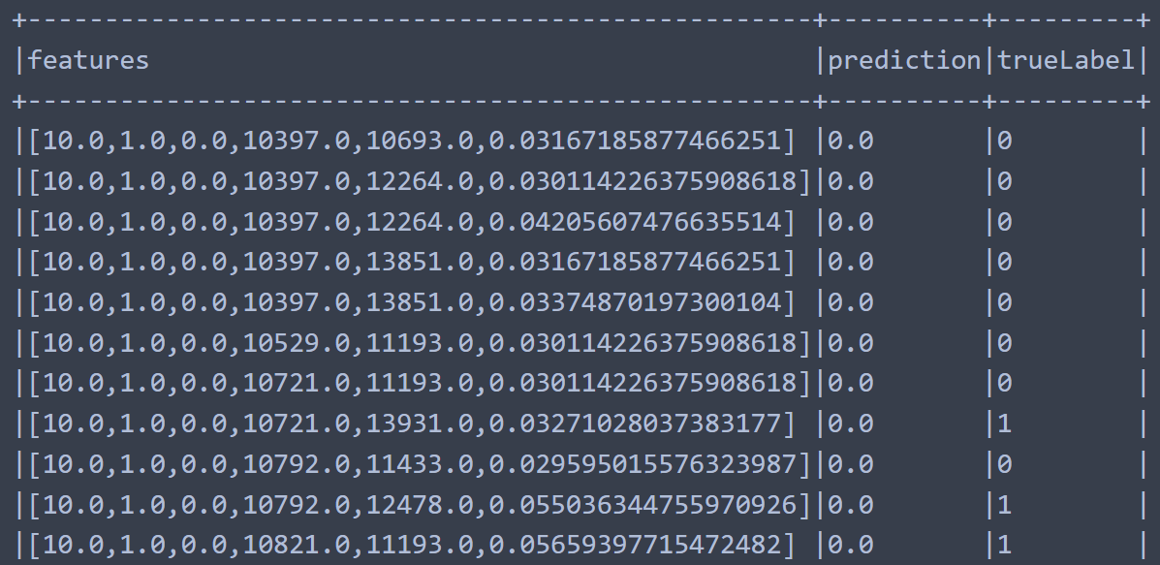
Output

Slide 18
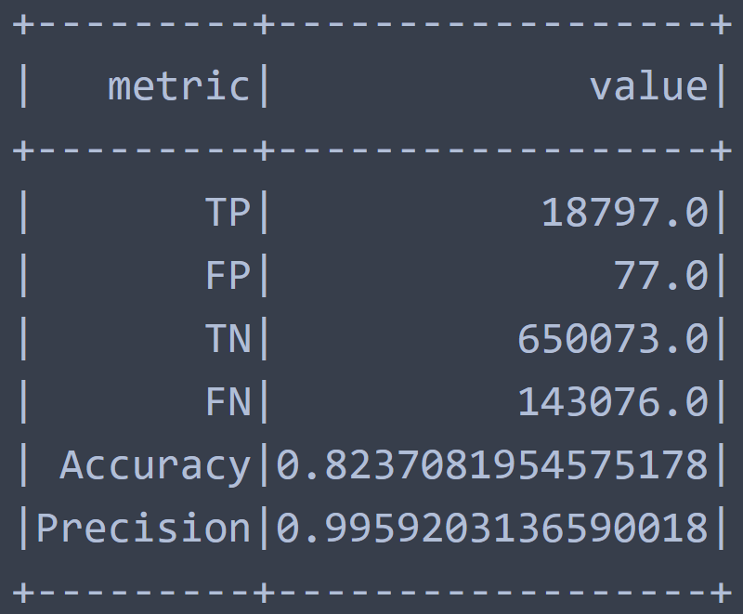
Output

Slide 19

Conclusion
To the best of our knowledge, we have explained about the applications of PySpark and its use in building Machine Learning Models and we have successfully implemented and executed it.
Finally, we conclude by saying that we as a team understood the importance of PySpark and its applications in dealing large datasets, and the various machine learning models building through it.

Slide 20
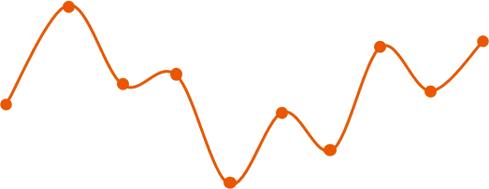
☺☺☺☺☺☺☺☺☺☺☺☺☺☺☺☺☺☺☺☺
Thank You
☺☺☺☺☺☺☺☺☺☺☺☺☺☺☺☺☺☺☺☺

